Slide 1
Transmit and Receive LIS3DH Accelerometer Data By Integrating Arduino Mega 2560 Microcontrollers and NRF24L01 Trans receiver modules
CPE 301 Spring 2018 Final Project
By
Monty Sourjah
sourjahm@unlv.Nevada.edu

Slide 2
Goal:
The goal of this project is to transmit and receive measured accelerometer data using a microcontroller and NRF24L01 module and display the measured values in the PC serial monitor.
Step 1
Collect and display the LIS3DH “X”,” Y”,” Z” values in the PC serial monitor implementing the I2C protocol. Setup the NRF24L01 trans receiver to transmit “X”,” Y” and “Z” values to the receiver.
(LIS3DH+Mega 2560+NRF24L01+PC serial monitor).
Step 2
Setup the receiver NRF24L01 module to receive data from the transmitter and display received data in the PC serial monitor.
(Mega 2560+NRF24L01+PC serial monitor)

Slide 3
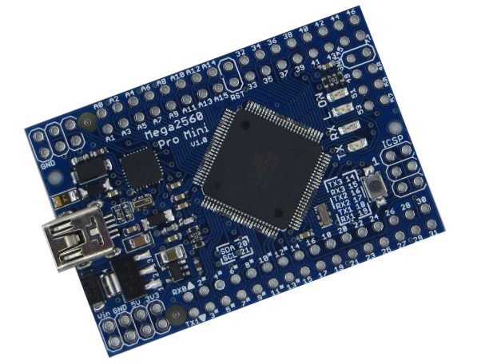
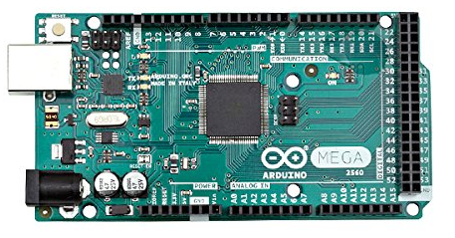
Components
Arduino Mega 2560 Board
Mega 2560 Pro Mini
The Arduino Mega 2560 is a microcontroller board is based on the ATmega2560 chip by Atmel.
It has 54 digital input/output pins (of which 14 can be used as PWM outputs), 16 analog inputs, 4 UARTs (hardware serial ports), a 16 MHz crystal oscillator.
This particular board control the receiver unit.
This particular board is identical to Arduino genuine 2560 board.
It also based on Atmega 2560 chip by Atmel.
This board control transmitter unit.

Slide 4
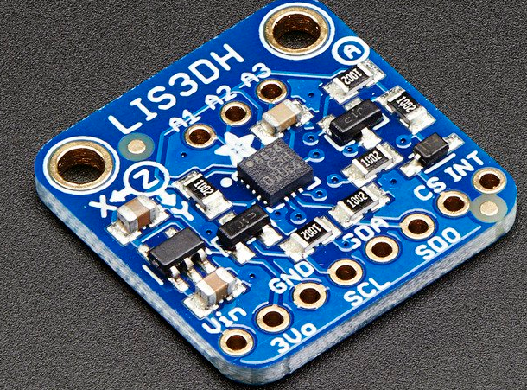
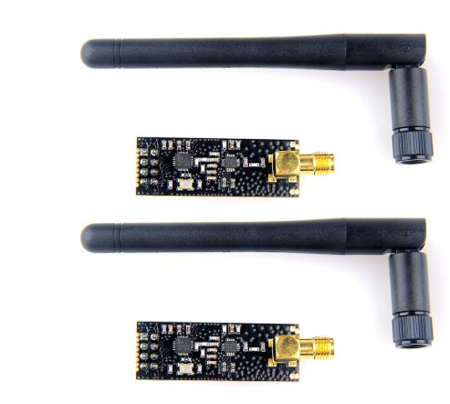
Interfaces Arduino Mega 2560 – LIS3DH using I2C – Address (0x33) Arduino Mega 2560 - nRF24L01 using SPI - uint8_t to_address[5] = { 0x01, 0x01, 0x01, 0x01, 0x01 };
LIS3DH Accelerometer
LIS3DH is a low power triple-axis accelerometer from Adafruit.
It can be interfaced with the microcontroller either SPI or I2C protocols.
MakerFocus 2pcs NRF24L01+PA+LNA Wireless Transceiver RF Transceiver Module 2.4G 1100m with Antenna

Slide 5
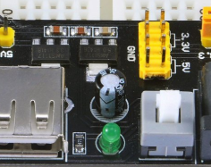
Components
DC Power Supply Module 3.3V/5.0V
In put voltage between 7V and 12V

Slide 6
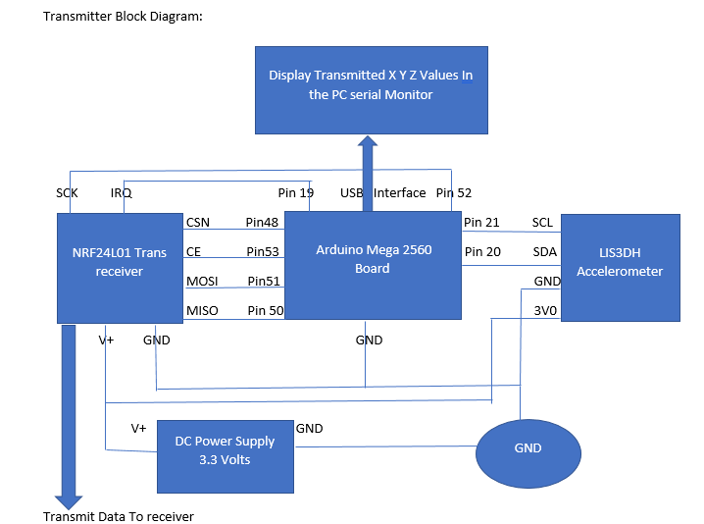

Slide 7
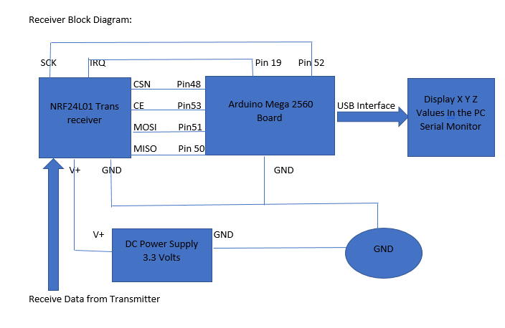

Slide 8
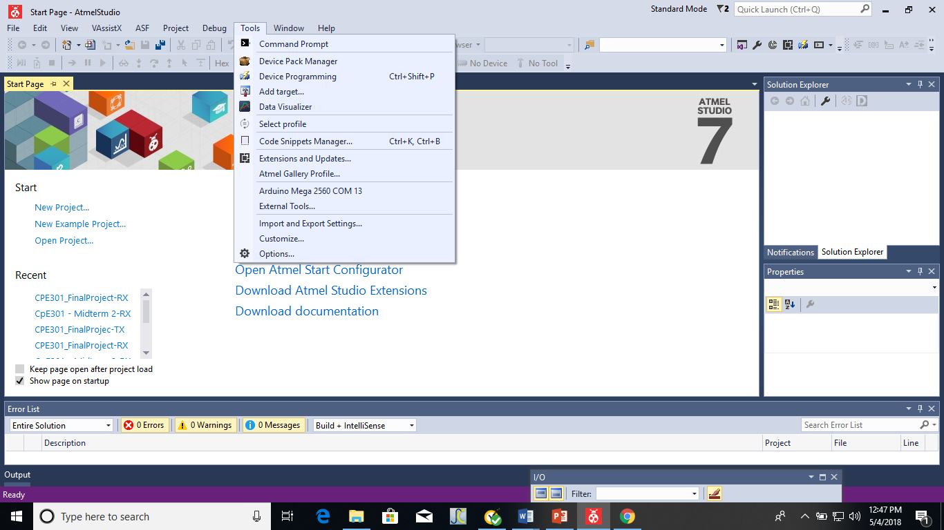
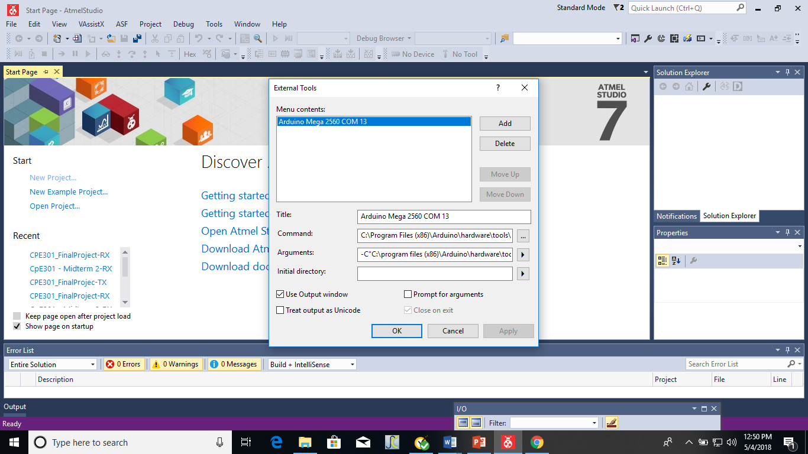
Upload C code from Atmel studio7 to Arduino mega 2560 board
Click on tools menu in Atmel studio 7
Open External tools

Slide 9
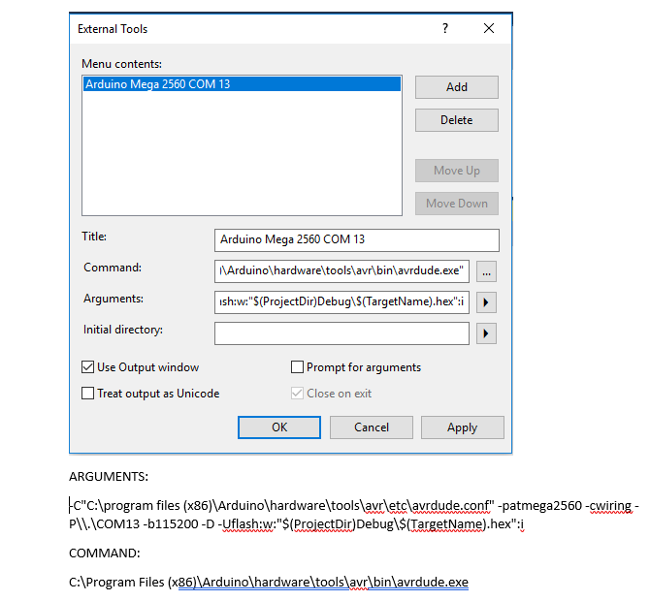

Slide 10
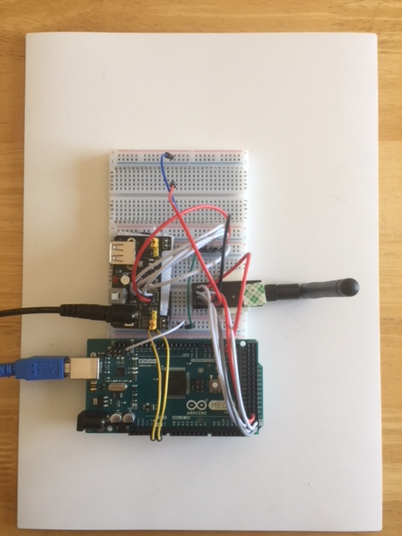
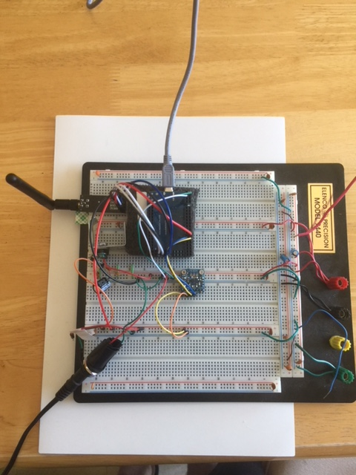
Transmitter and Receiver Setups On The Bread Board
Transmitter Setup
Receiver Setup

Slide 11
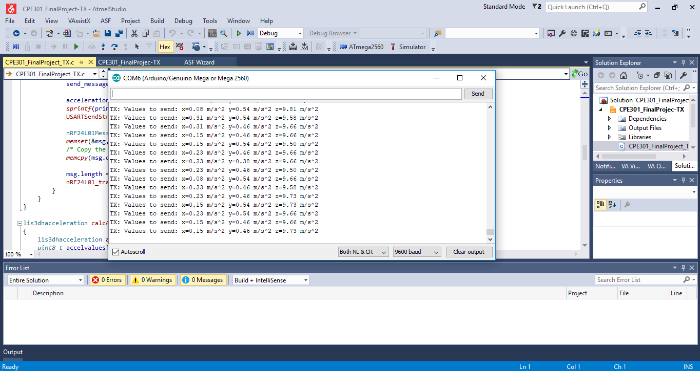
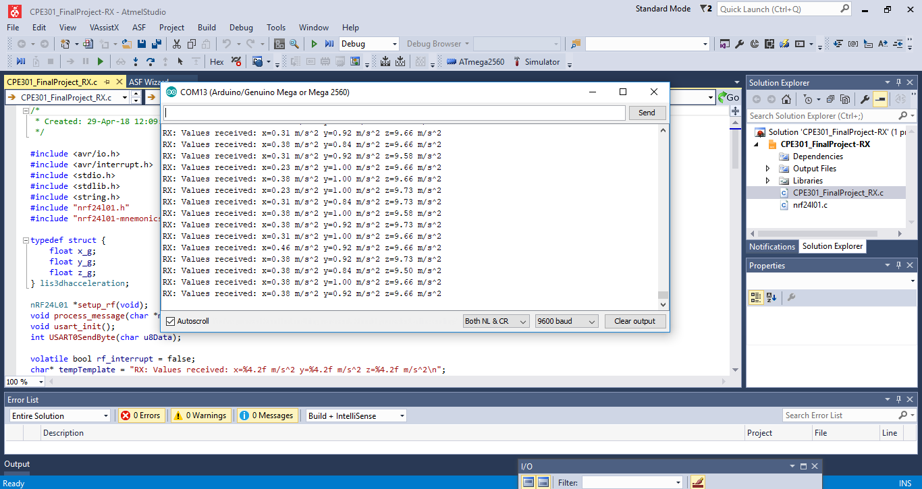
Transmitted and Received Accelerometer Data
Transmitted Data
Received Data

Slide 12
Links For The Project
http://www.youtube.com/watch?v=1GTnE82lnQ8
https://github.com/ballasl/CPE301_Final-Project

